Slide 1
Software Engineering Approach to Human-Computer-Interaction
Chapter 2 Interaction Design Process

Slide 2
Contents
2.1 Basic Activities and Key Features
2.2 Issues in Design Process
2.3 Interaction Design Life Cycle

Slide 3
2.1 Basic Activities & Key Features

Slide 4
What is Design?
A simple definition
Achieving goals within constraints
It can help to focus on certain things:
Goals
Constraints
Trade-off

Slide 5
Goals
What is the purpose of the design we are intending to produce?
Why do they want it?

Slide 6
Constraints
What materials must we use?
What standards must we adopt?
How much can it cost?
How much time do we have to develop it?
Are there health and safety issues?

Slide 7
Trade-off
Choosing which goals or constraints can be relaxed so that others can be met.

Slide 8
What is Interaction Design?
Interaction Design (IxD)
Defines the structure and behavior of interactive systems.
Designing interactive products to support the way people communicate and interact in their everyday and working lives.
The design of spaces for human communication and interaction.

Slide 9
Interactive Design Discipline
Industrial Design
& Visual Design
User Center Design
Interaction
Design
User Interface Design
Human
Factors
Usability
Engineering
HCI
Notes:
交互设计学科

Slide 10
HCI & IxD

Slide 11
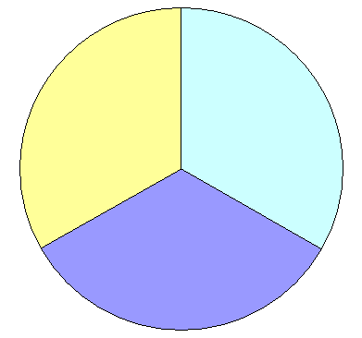
Interactive Design System
♢商业生态系统
♢整合创新
Business System
Business Innovation
♢商业模式画布
♢品牌价值
♢接触点策划
♢传播设计
User Experience Design
♢商业计划
♢社会媒体
服务设计 交互设计
原型设计 视觉设计
设计评估 用户研究
♢企业流程规划
♢媒体运营
♢交互界面开发
♢UI开发
♢数据挖掘
♢信息架构
♢信息可视化
♢模拟系统开发
Information techniques

Slide 12
Goals of IxD
Develop usable products
Usability means easy to learn, effective to use and provide an enjoyable experience
Involve users in the design process

Slide 13
Academic Disciplines contributing to IxD
Psychology
Social Sciences
Computing Sciences
Engineering
Ergonomics
Informatics

Slide 14
Design Practices Contributing to IxD
Graphic design
Product design
Artist design
Industrial design
Film industry

Slide 15
Interdisciplinary Fields in IxD
HCI
Ubiquitous Computing
Human Factors
Cognitive Engineering
Cognitive Ergonomics
Computer Supported Co-operative Work
Information System

Slide 16
Basic Activities
Identify users need and build requirements
Develop alternative design schemes
Conceptual Design
Physical Design
Build interactive version for design
Evaluate design

Slide 17
Relationship among Activities
Identify requirements
Develop alternative
design schemes
Evaluate design
Build interactive
version
Final Product

Slide 18
Key Features
User centered
Stable usability standards
Iteration

Slide 19
2.2 Issues in Design Process

Slide 20
Four Issues
How to select user
How to identify requirements
How to propose alternative design schemes
How to select a proper design scheme

Slide 21
How to select user
Stakeholders ≠ Users
Customers may not be the users
Users should be classified
Primary
Who actually use the system
Secondary
Who do not directly use the system, but receive output from it or provide input to it
Tertiary
Who do not fall into either of the first two categories but who are directly affected by the success or failure of the system
Facilitating
Who are involved with the design, development and maintenance of the system

Slide 22
How to identify requirements
Know users
Who are they?
Probably not like you!
Talk to them
Watch them
Use your imagination

Slide 23
How to propose alternative design schemes
Consider other similar designs
Consider design constraints

Slide 24
How to select a proper design scheme
Design decision
About outside features
About inside features
Consider users’ experience, preference and improvement suggestion
Consider “quality”

Slide 25
2.3 Interaction Design Life Cycle

Slide 26
Development Process
Traditional Software Life Cycle Model
Interactive Design Life Cycle Model

Slide 27
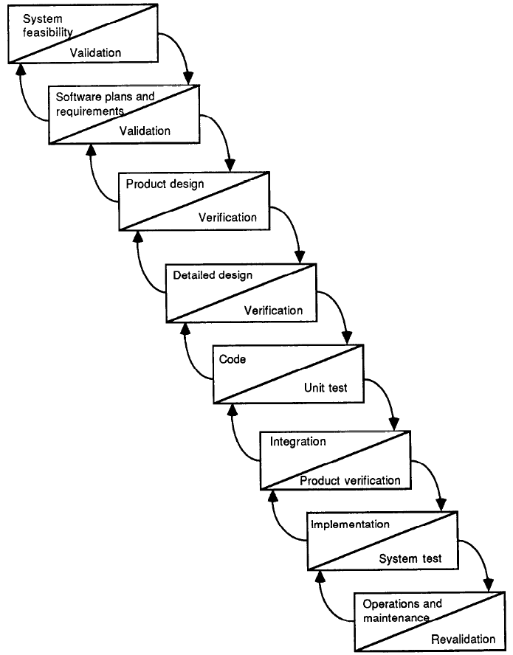
Waterfall Process (Traditional)

Slide 28
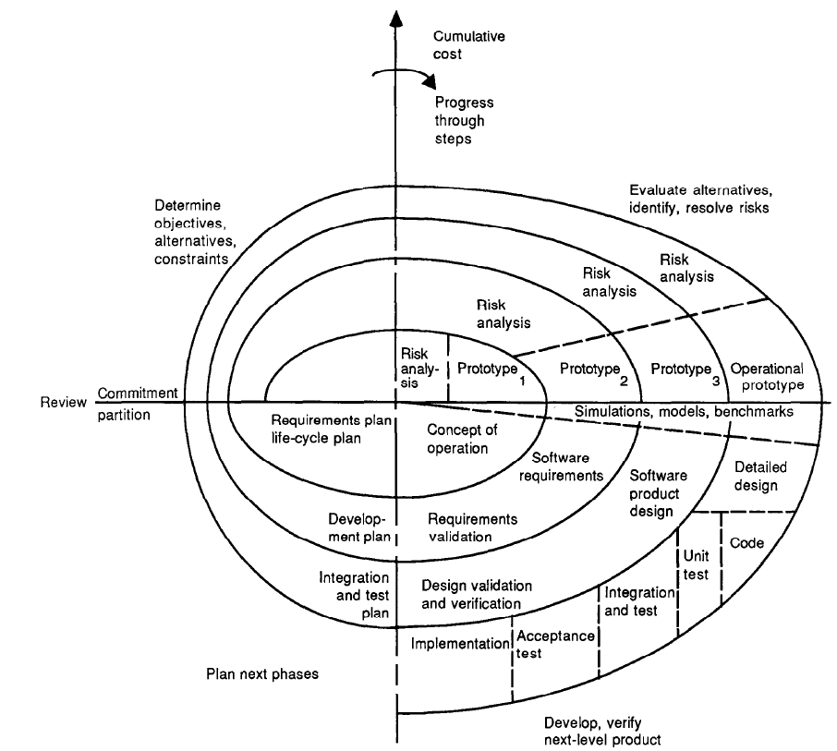
Spiral Process (Traditional)

Slide 29
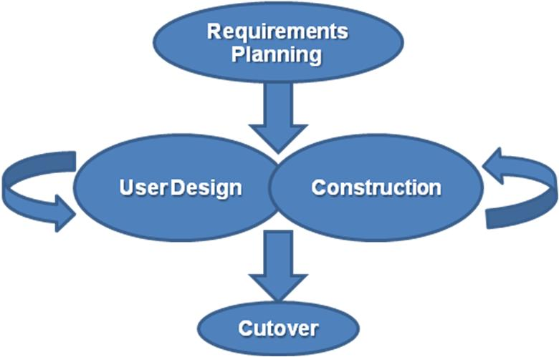
RAD (Traditional)
Rapid application development

Slide 30
Prototyping (Traditional)
Throw-away
The prototype is built and tested. The design knowledge gained from this exercise is used to build the final product, but the actual prototypes discarded.
Evolutionary
The prototype is not discarded and serves as the basis for the next iteration of design.

Slide 31
Star Life Cycle Model (IxD)
Realization
Task /Function Analysis
Prototyping
Evaluation
Requirements Specification
Conceptual Design/ Formal Design

Slide 32
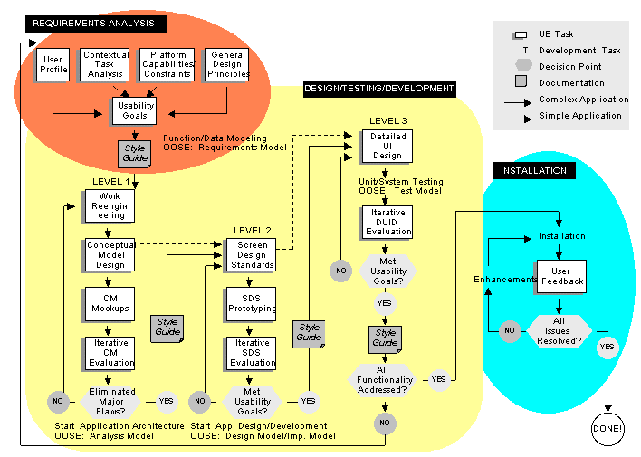
UE Life Cycle

Slide 33
Interaction Design Process
What is wanted
Scenarios
Task analysis
Interviews
Ethnography
What is there
Vs.
What is wanted
Analysis
Guidelines
Principles
Design
Dialog
notations
Prototype
Implement &
deploy
Evaluation
Heuristics
Architectures
Documentation
Help

Slide 34
Professionals in IxD Design Process
Interaction designers
People involved in the design of all the interactive aspects of a product
Usability engineers
People who focus on evaluating products, using usability methods and principles
Web designers
People who develop and create the visual design of websites, such as layouts
Information architects
People who come up with ideas of how to plan and structure interactive products
User experience designers
People who do all the above but who may also carry out field studies to inform the design of products

